Slide 1
Open Digital Zanzibar
Abdillah U.Abubakar BCS/11/16/230/TZ
Abdul-rahman M.Hafidh BITAM/4/16/173/TZ
Supervisor: Mr.Ali Abdullah

Slide 2


Slide 3
Introduction
The project involve a platform (Mobile and web) which will include latest map of Zanzibar and Zanzibar land plan . So, the citizens can be aware. The main objective is to create a platform which all stakeholders can access. So, they can be aware of the infrastructures and assets found and what are the future plans of the country regarding land use. The main client is Commission for Land (CoLa) of Zanzibar.

Slide 4


SDLC Methodology
Waterfall Model
Rapid Prototyping
Tip
During implementation, we will do rapid prototyping for the sake of inclusivity with our clients. And we will keep iterating from there.

Slide 5
Software Development Approach.
Object Oriented
Tip
the nature of the programming language which will be used is object oriented i.e Java

Slide 6
Requirement Gathering Techniques
Interview with Commission for Lands (CoLa)
Survey through google forms
Tip
We used tools like HCD & Design Thinking in Requirement Gathering

Slide 7
Feasibility study
Economic : Yes
Operational : Mmmh. Yess
Schedule : Mmmh.Yes
Technical :Yes
Legal : Yes
Marketing : Yes

Slide 8
CoLa INTERVIEW GUIDE
Presentation of project proposal
Continue the conversation with their insights and feedback regarding the presentation
Follow with general questions like
- Tell us more about last time …
-What did you like most about …
- What did you like least about or find most frustrating about...
Follow with specific questions like
*You mentioned ________ . Tell us more about this. WHy do you want it that way?
*Have you ever done it differently? Why? How?
*Has anything changed in the way you do this overtime? WHy? How?

Slide 9
Google form questions
Intro to the object
Occupation
-Do you believe there is a need for a project like this?
Why? (short answer)
-What is your concern regarding a project like this ? Politics, Security, Politics, Others
if others, please mention.
-*What features would be great to have on the app?
*Please provide any recommendations or suggestions.

Slide 10
Through Google Forms survey we got about FIFTY RESPONSES from different stakeholders ranging from students, experts, activists,teachers, engineers, civil servant and others.

Slide 11
What people are saying
It will help tourists. But it should be easy to use.
Student
It will help the citizens in getting quick feedback on land use in Zanzibar.
Land planner
Ensuring the security of the personal information should be priority
Civil Servant
Quotes from Interview & Google forms

Slide 12
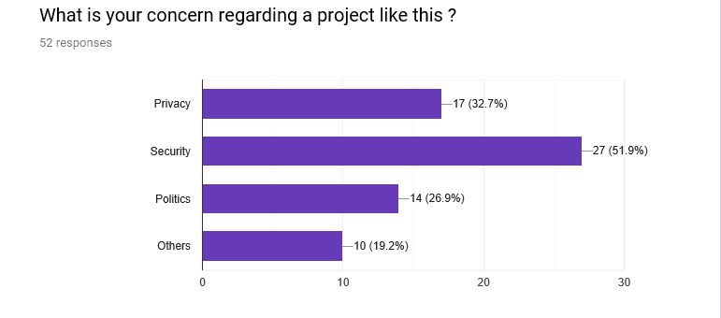

Slide 13
Functional requirement
oThe application will contain current map from ZMI data.
oThe application will contain master plan of Zanzibar.
oThe application will load according to user current location.
oThe authorized personal will be capable of uploading the layer to the application from server side.
oAdministrator can approval the changes could be made by authorized user of the system.

Slide 14
Non Functional requirement
oThe application will easy to use and user friendly.
oThe application will only display only data the allowed to be shown (Only legal data).
oThe application will be accessible all the time through internet.
oThe platform will be faster and responsive.
oThe application will need minimal memory to work and operate.
oIn term of scalability the application will be increasing if needed.

Slide 15
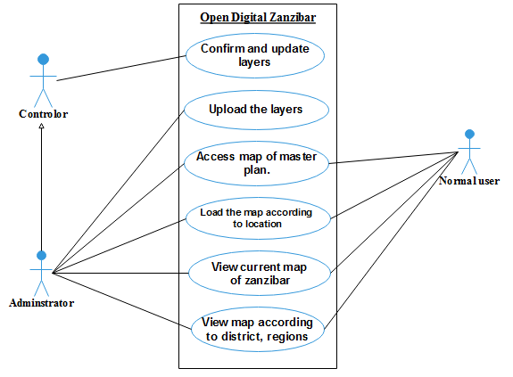
Use Case

Slide 16
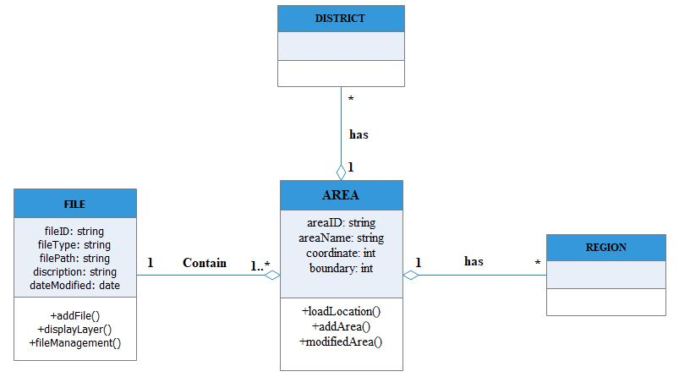
Class Diagram

Slide 17
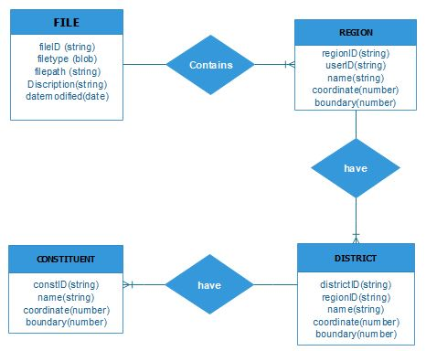
ERD

Slide 18
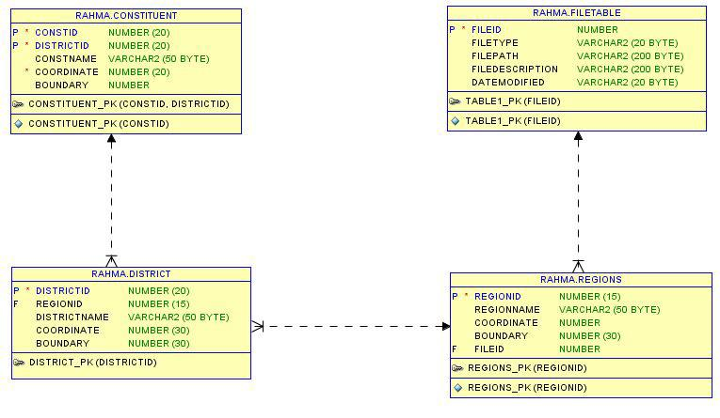
Relational model

Slide 19
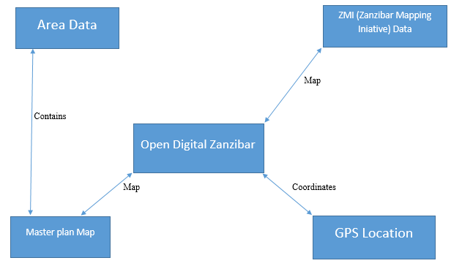
Architectural Design

Slide 20
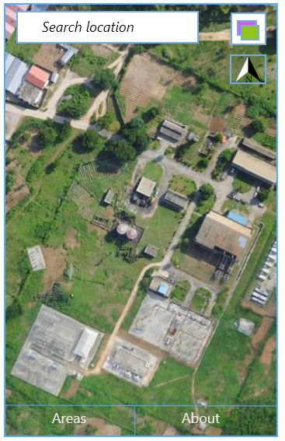
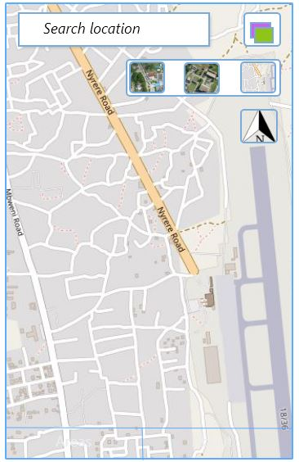
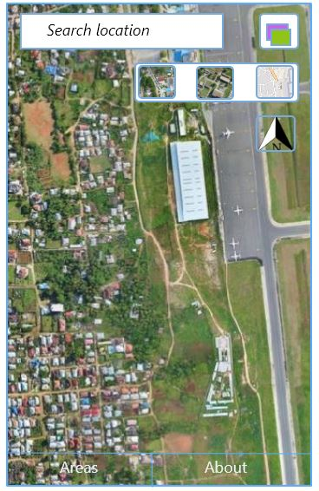
Mobile App Layout

Slide 21
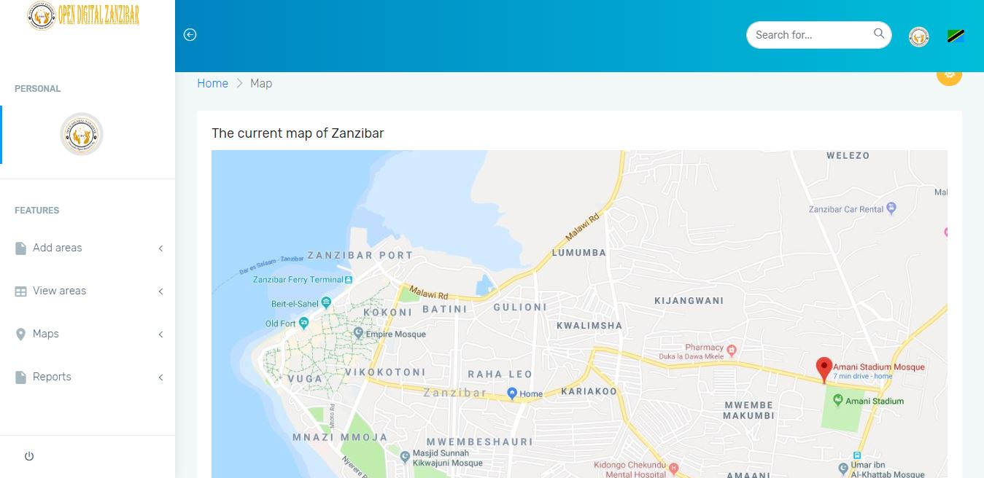
Web Layout

Slide 22
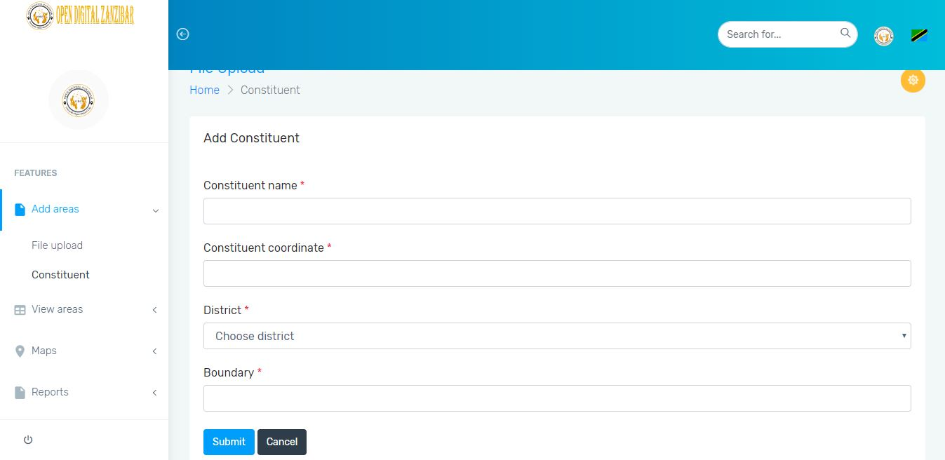
Form Sample

Slide 23
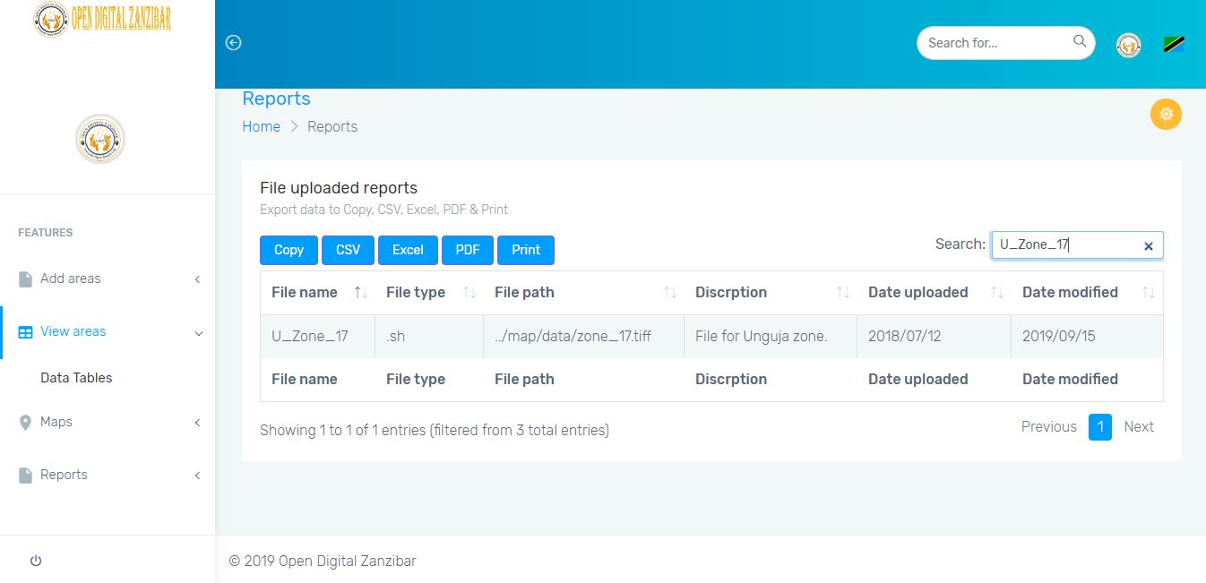
Report Sample

Slide 24
Thank you!
Feel free to ask any questions.
And We hope to have more constructive feedback and insights from you.
For more feel free to visit our git repository
https://github.com/amhafidh/OpenDigitalZanzibar
The future is exciting

